Slide 1

Intro to NServiceBus
6 – Publish And Subscribe

Slide 2
How to create a Pub Sub System
Published messages must support IEvent
Client registers subscription intent
Publisher optionally declares itself AsA_Publisher
Will provide persistence to subscriptions
Publisher calls Bus.Publish
Messages get delivered

Slide 3
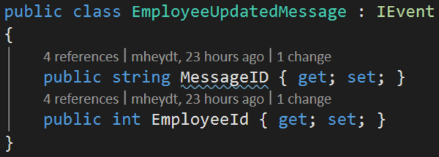
Implement IEvent
NServiceBus only allows objects implementing IEvent to be published

Slide 4
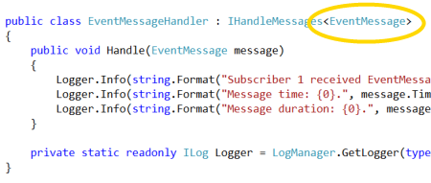
Client subscription intent
Like IHandleMessages, but for subscriptions
Type must implement IEvent

Slide 5
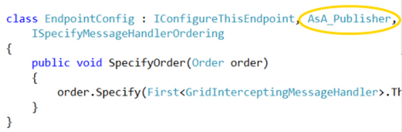
Server Declares itself AsA_Publisher
This is optional, but allows persistence of subscriptions
The process of subscription is tracked, controlled and can be secured

Slide 6
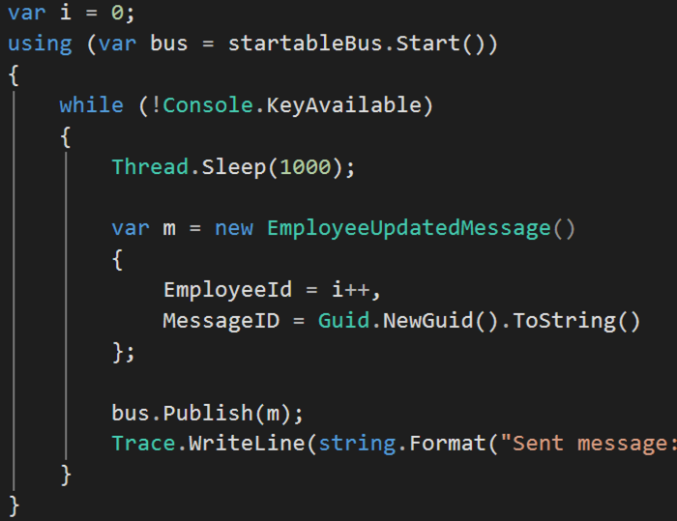
Publisher sends messages when it feels like it
And NServiceBus delivers it to all subscribers

Slide 7
Other options in Pub Sub
Subscription request can be authenticated
Multiple message types can be published to a queue
Clients can listen for only specific types of messages

Slide 8
Demo: Pub Sub

